Slide 1


Project Info
Pages
Concepts used
Future Improvements
Open Session
Front-End developer:
Diana Stanculescu

Slide 2








Project Info
Technologies used:
Visual Studio Code
JSON
Tools Used:
HTML, CSS
BootStrap
MockAPI, GhitHub
FontAwesome
JavaScript
Online shop for home design

Slide 3
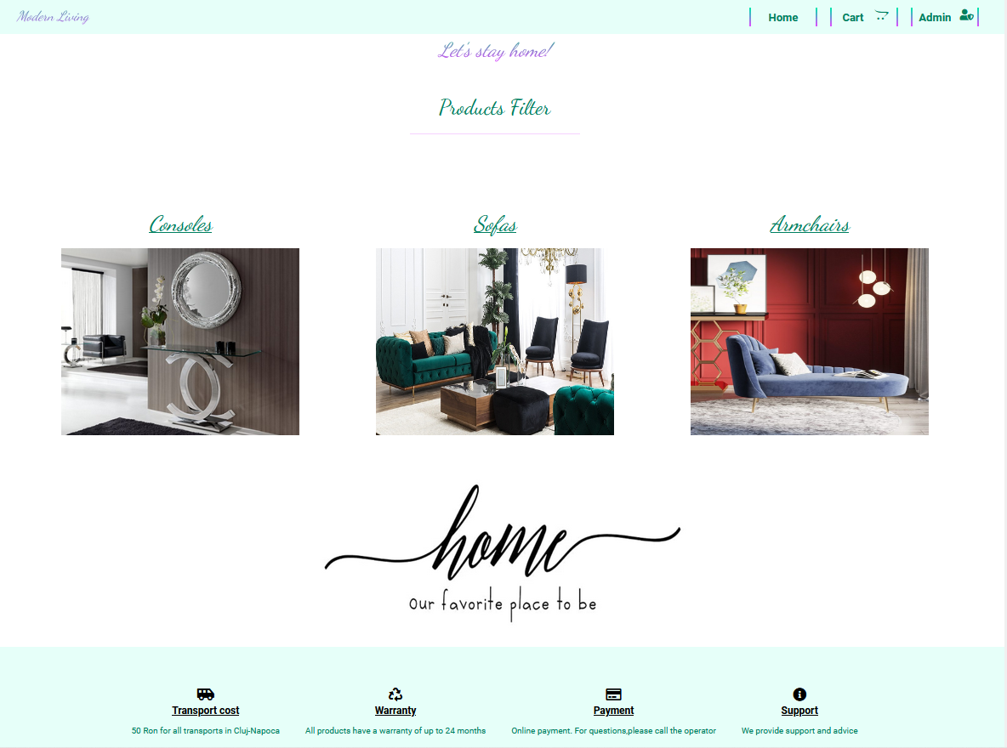

Slide 4
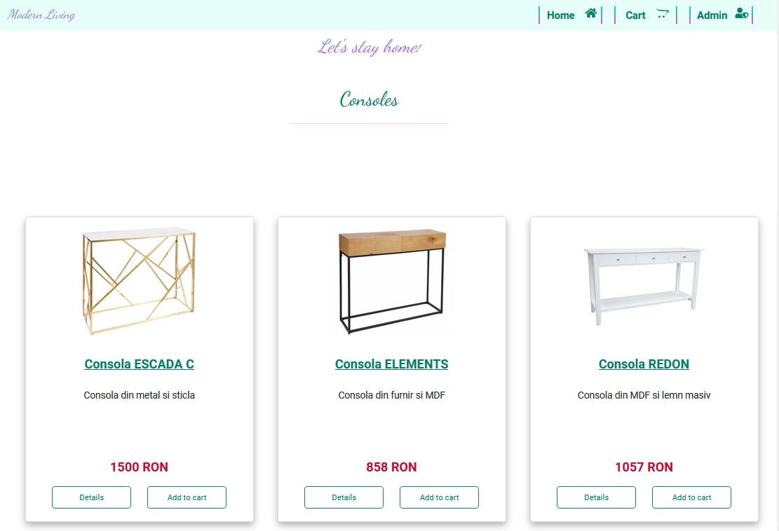

Slide 5
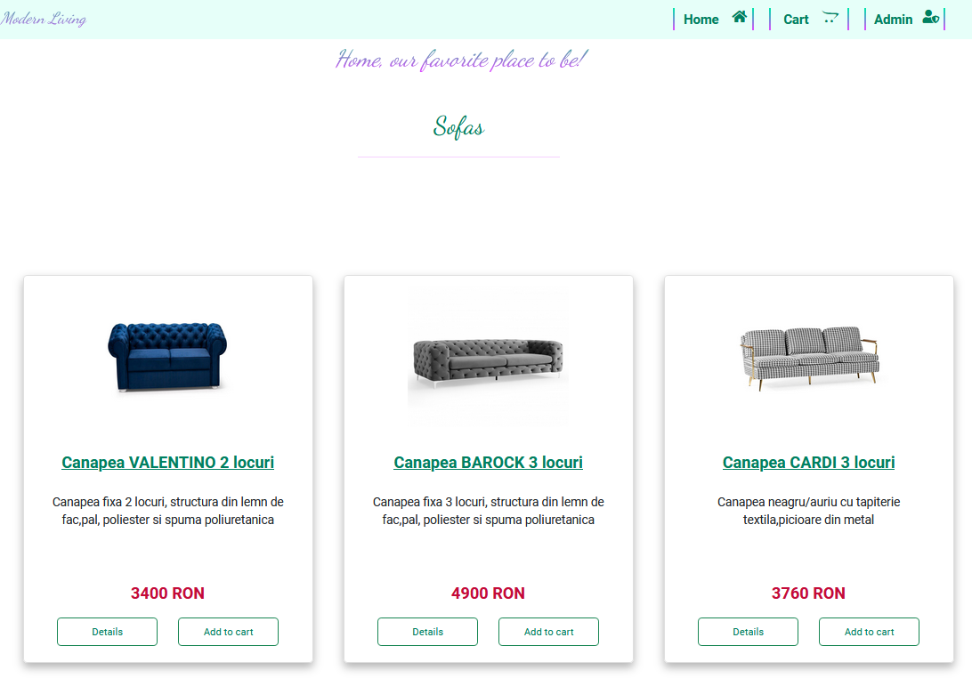

Slide 6
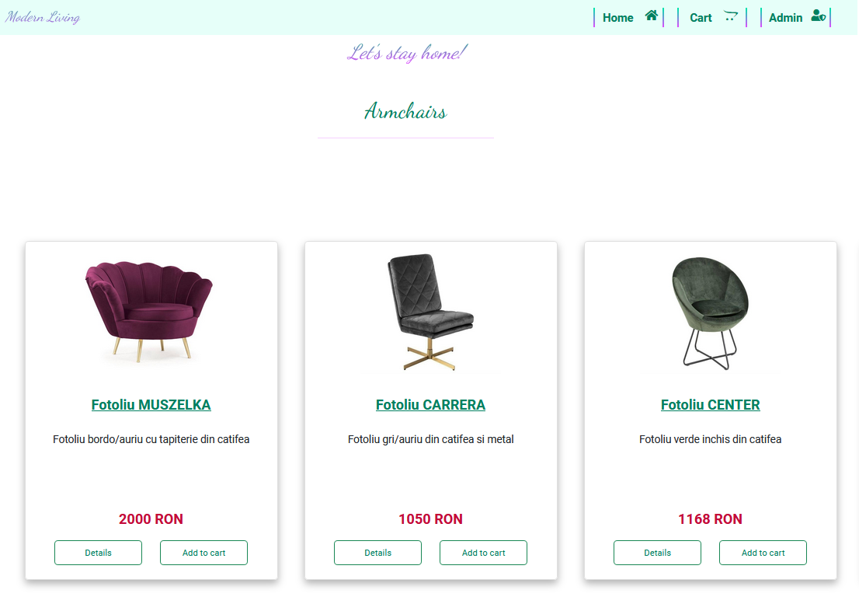

Slide 7
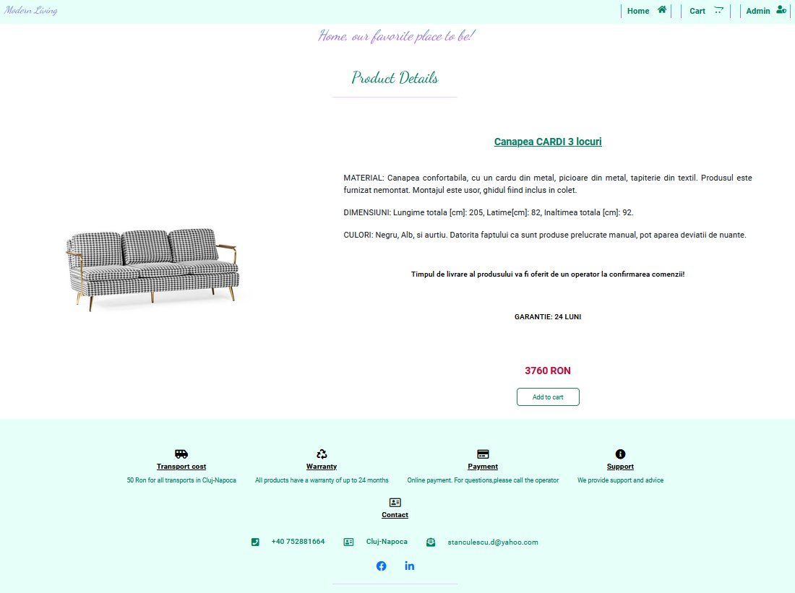
User has the possibility to check the material and dimensions of the product
User has the possibility to view the image on a larger scale

Slide 8
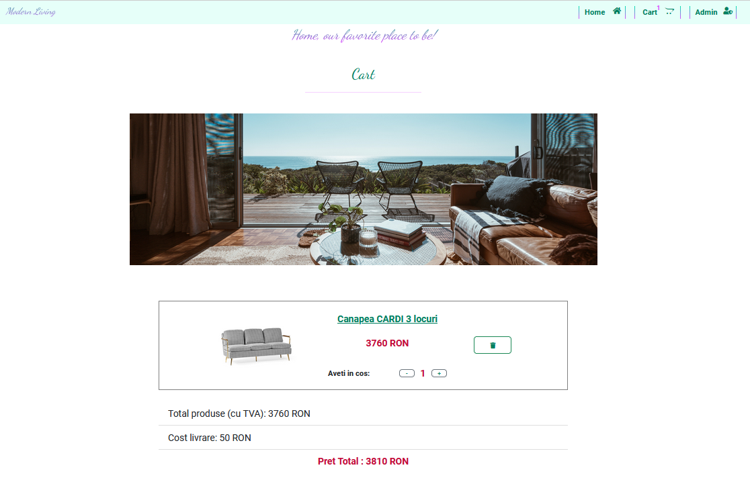
Back to Home button
Cart icon is updated in real time
User has the possibility to delete a product
User has the possibility to change the desired quantity
Total price is recalculated with every change

Slide 9
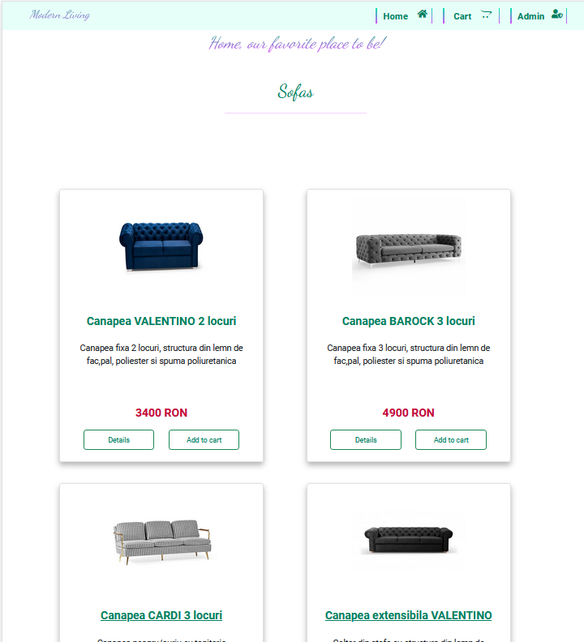
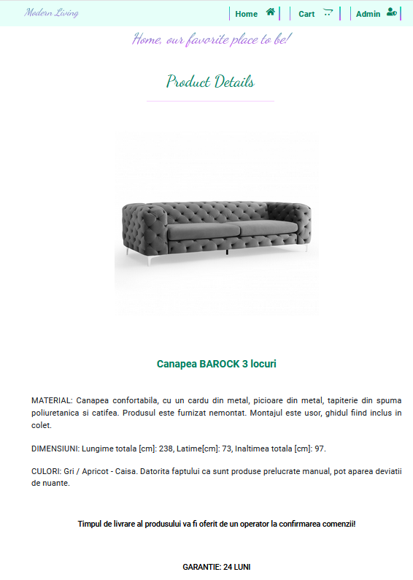
Responsive Webpage

Slide 10
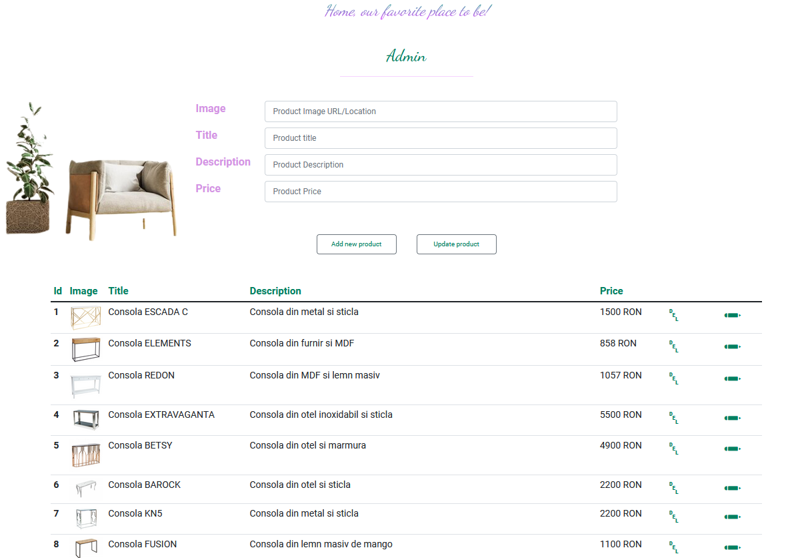
Admin has the possibility to edit an item
Admin has the possibility to delete an item
Admin has the possibility to add a new item
Admin has the possibility to update an item

Slide 11

Future Improvements
Search Bar
Log In for Admin
More images for each product
User should complete the shipping form and the payment method

Slide 12

THANK YOU

